Slide 1




LEMIX: Enabling Testing of Embedded Applications as Linux Applications
Sai Ritvik Tanksalkar, Siddharth Muralee, Srihari Danduri, Paschal Amusuo, James C Davis, Antonio Bianchi and Aravind Kumar Machiry

Slide 2
Contributions
LEMIX: Rehosts embedded apps as x86 Linux apps.

Slide 3
Contributions
LEMIX: Rehosts embedded apps as x86 Linux apps.
No Hardware or Emulation Required for Rehosting.

Slide 4
Contributions
LEMIX: Rehosts embedded apps as x86 Linux apps.
No Hardware or Emulation Required for Rehosting.
Evaluated on 18 Real World Applications across 4 RTOSes.

Slide 5
Contributions
LEMIX: Rehosts embedded apps as x86 Linux apps.
No Hardware or Emulation Required for Rehosting.
Evaluated on 18 Real World Applications across 4 RTOSes.
Found 21 previously unknown bugs, most confirmed and fixed.

Slide 6
Contributions
LEMIX: Rehosts embedded apps as x86 Linux apps.
No Hardware or Emulation Required for Rehosting.
Evaluated on 18 Real World Applications across 4 RTOSes.
Found 21 previously unknown bugs, most confirmed and fixed.
Superior to State-Of-The-Art in Coverage and Detection.

Slide 7
Background
and
Motivation

Slide 8

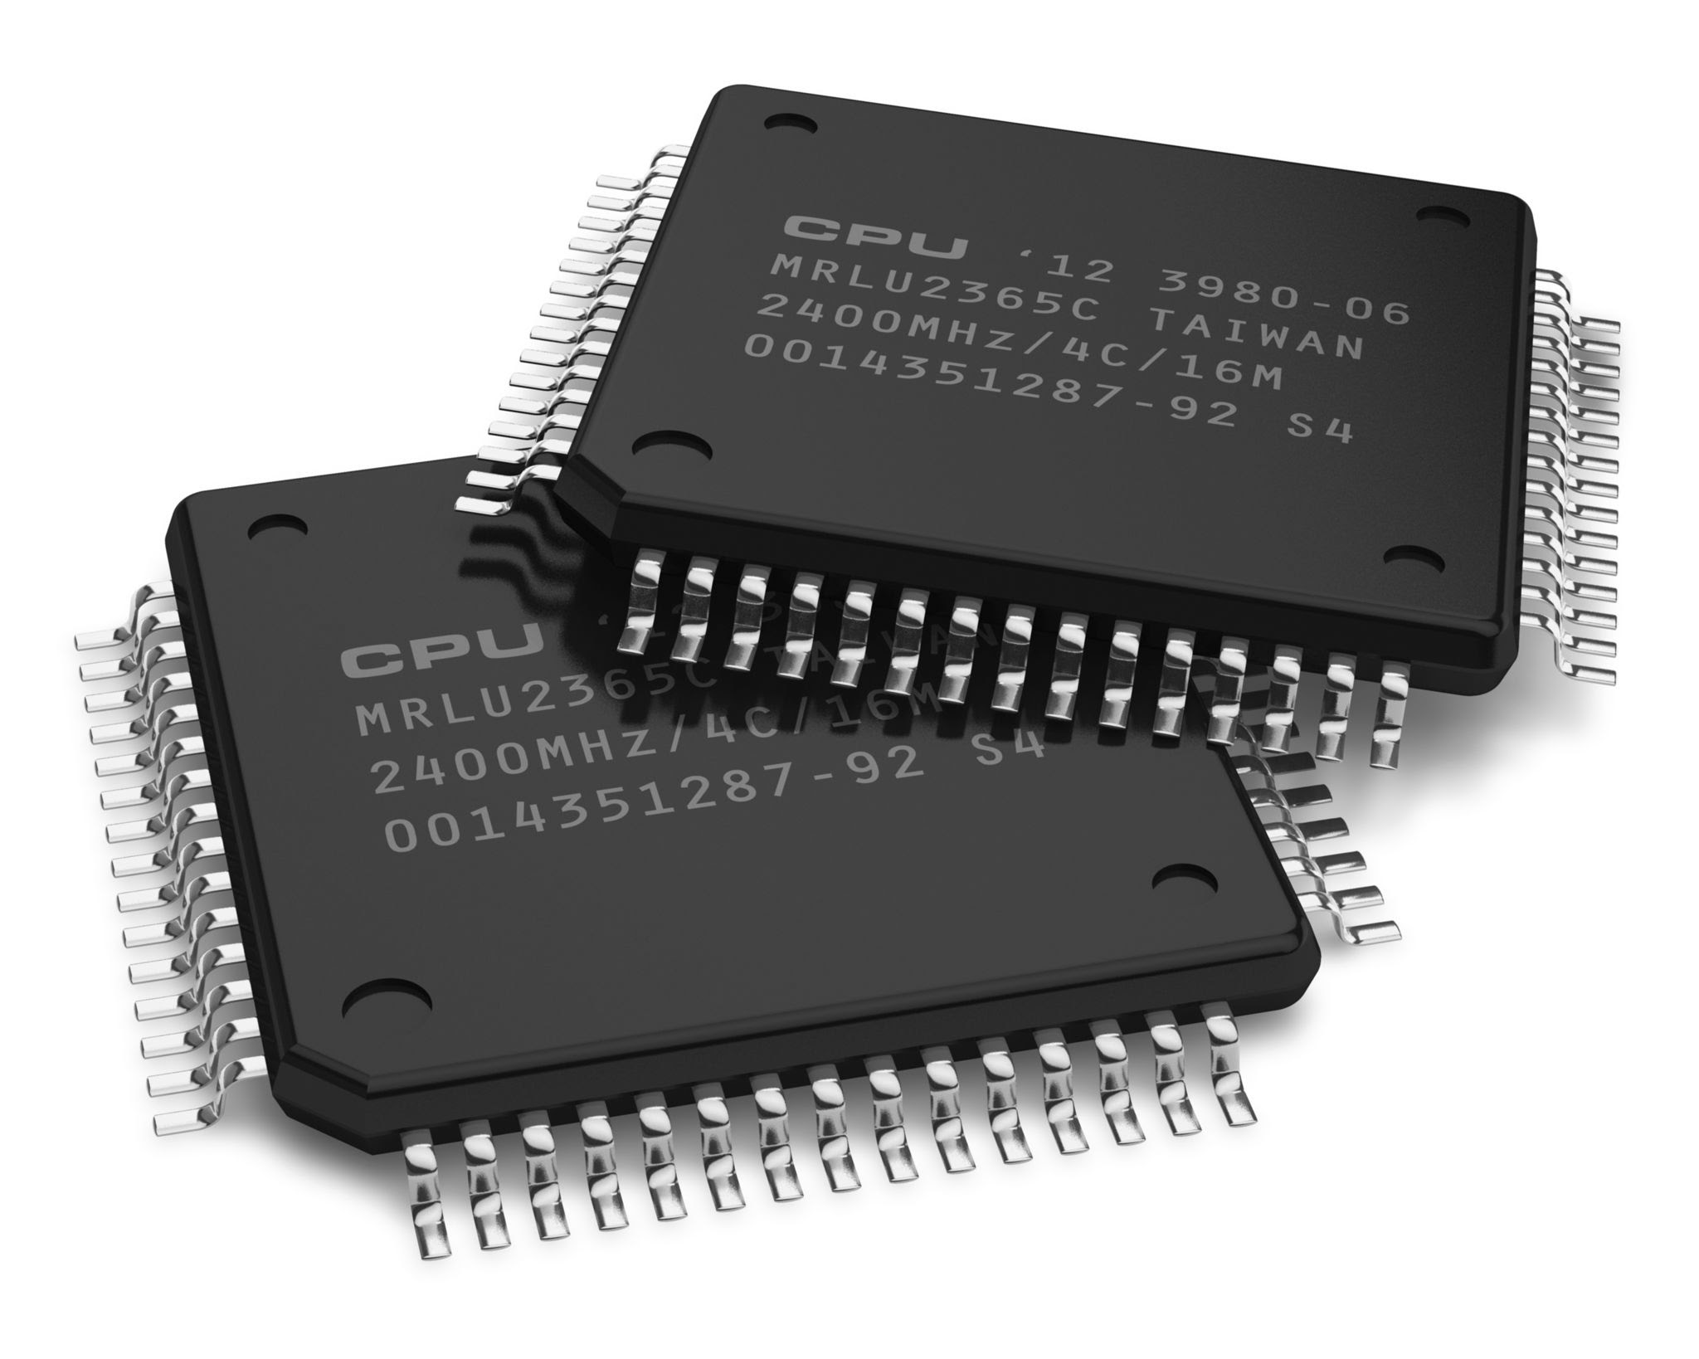
Diversity of Embedded Software
50+
Billion Devices in use.

Slide 9
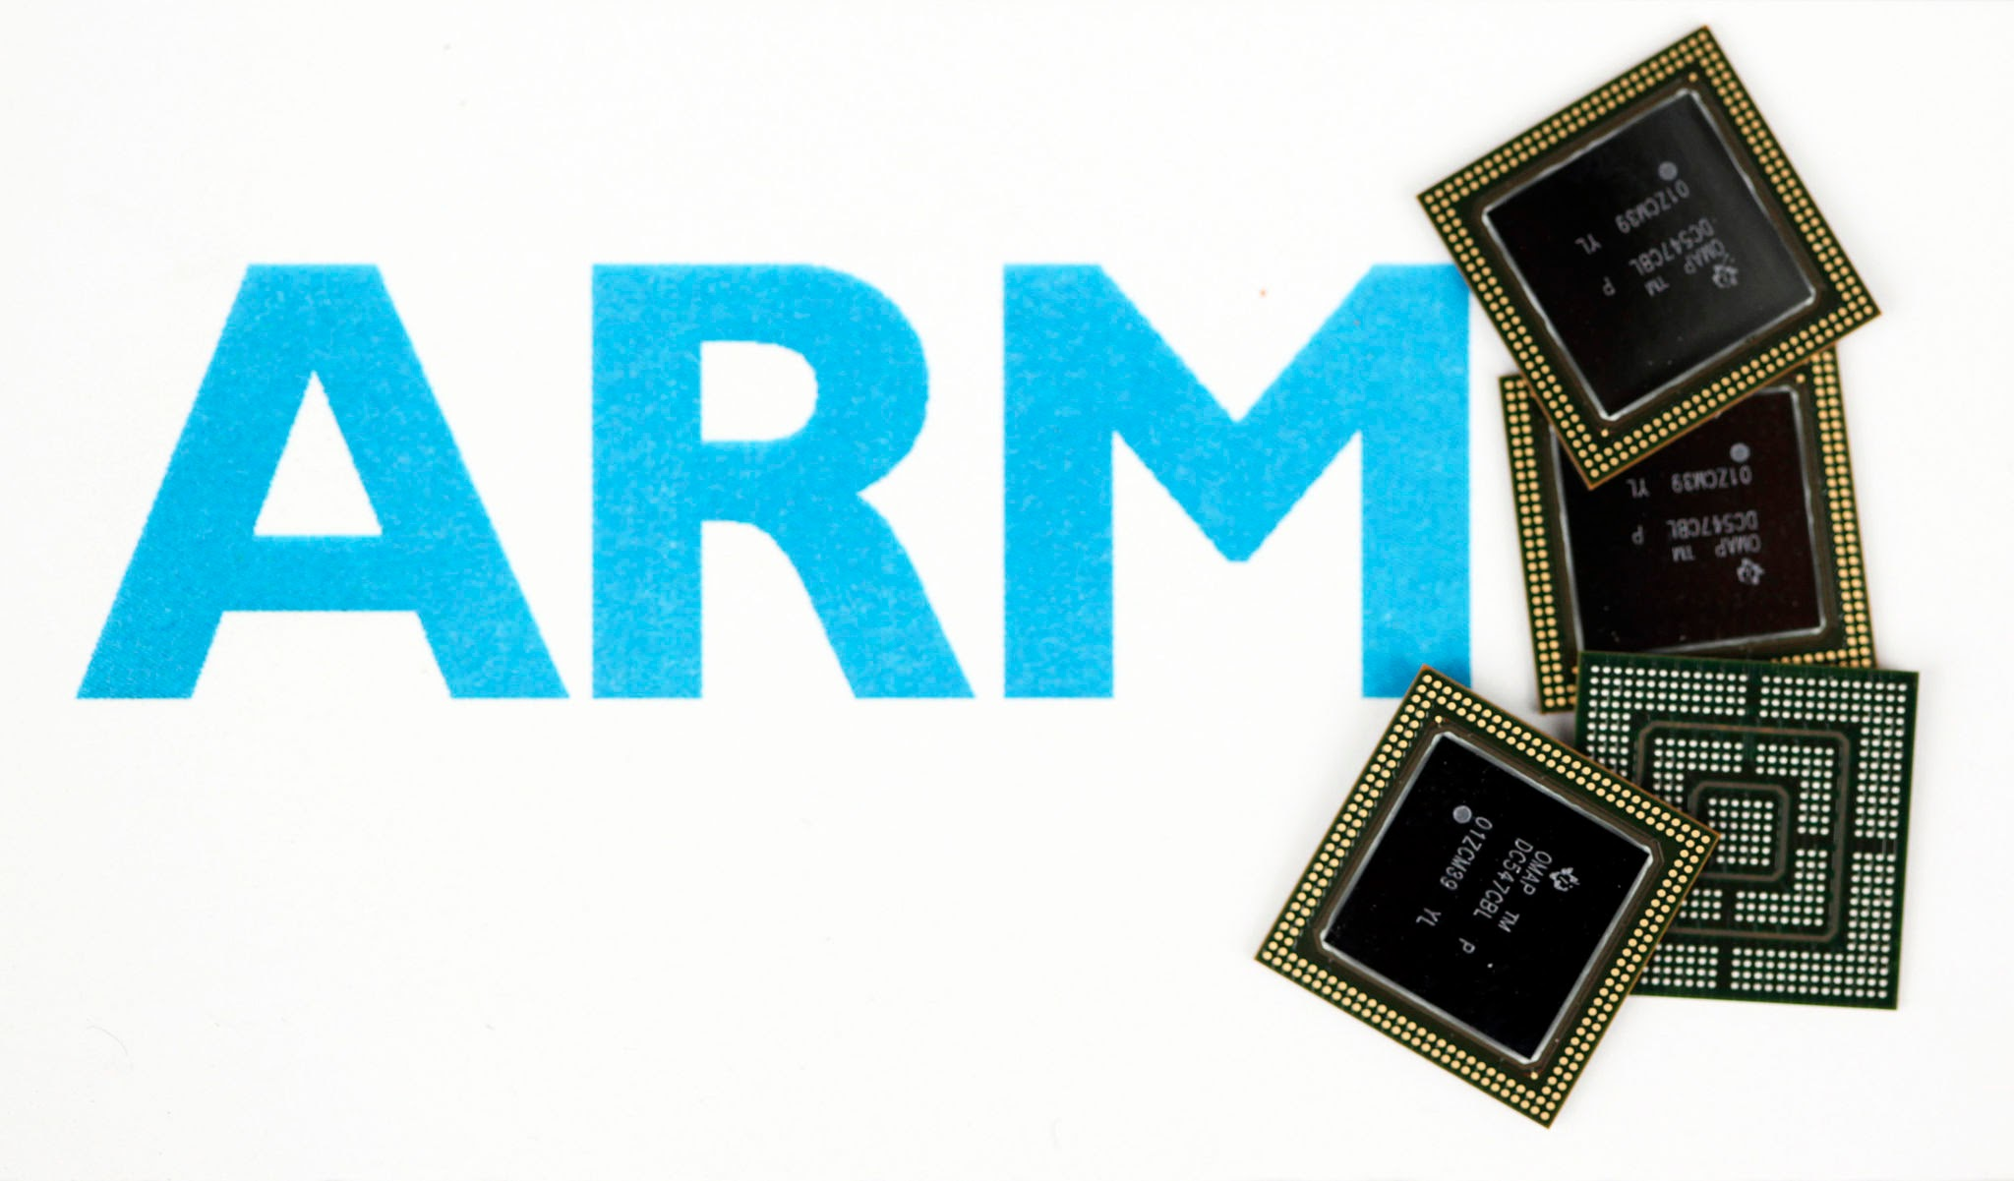
Diversity of Embedded Software
50+
25+
Billion Devices in use.
Diverse ISAs

Slide 10



Diversity of Embedded Software
50+
25+
Billion Devices in use.
Diverse ISAs
80%
Embedded Software in Unsafe Languages.

Slide 11

Diversity of Embedded Software
50+
25+
Billion Devices in use.
Diverse ISAs
80%
2k+
Embedded Software in Unsafe Languages.
New CVEs detected every year.

Slide 12
Testing Embedded Software

Slide 13

Testing Embedded Software : Rehosting
Rehosting

Slide 14

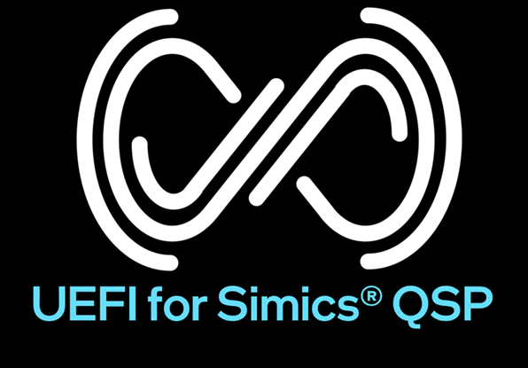
Testing Embedded Software : Rehosting
Rehosting
Execution in a non-native environment.

Slide 15
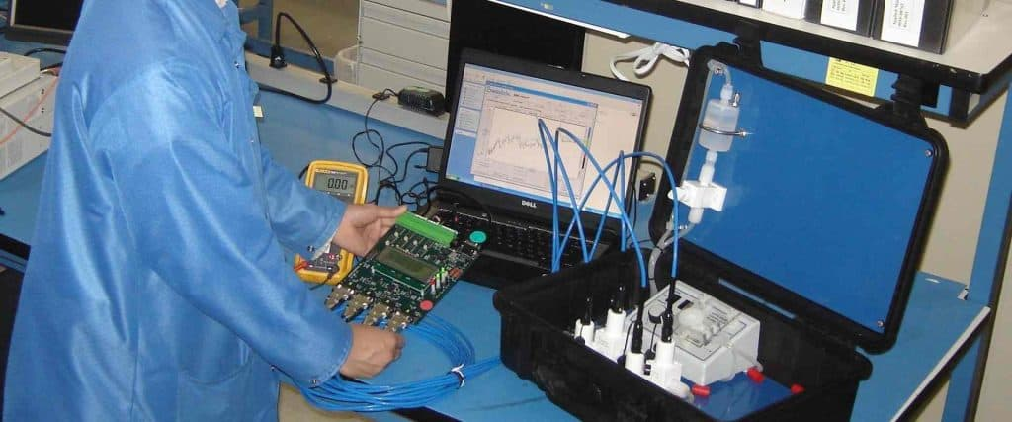
Testing Embedded Software : Rehosting
Rehosting
Execution in a non-native environment.
Bypass hardware constraints.

Slide 16
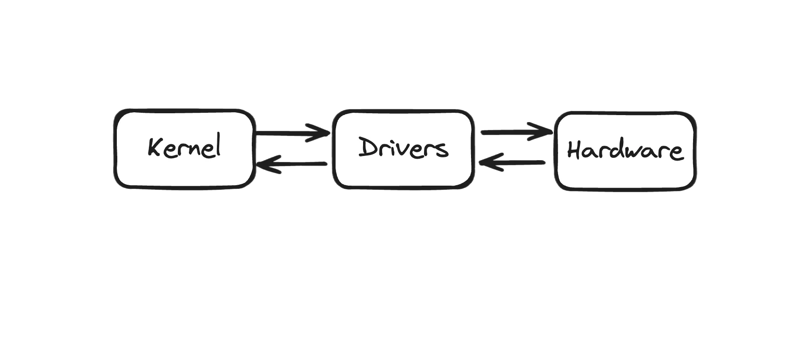
Testing Embedded Software : Rehosting
Rehosting
Execution in a non-native environment.
Bypass hardware constraints.
Handle hardware interactions.

Slide 17
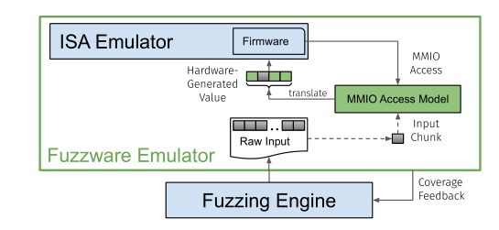
Testing Embedded Software : Rehosting
USENIX’22
Rehosting
Execution in a non-native environment.
Bypass hardware constraints.
Handle hardware interactions.
Fuzzware, Multifuzz, HALucinator etc.

Slide 18
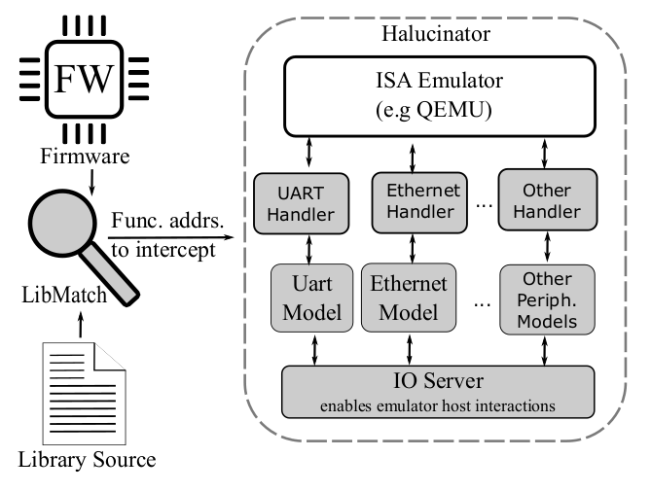
Testing Embedded Software : Rehosting
USENIX’22
Rehosting
Execution in a non-native environment.
Bypass hardware constraints.
Handle hardware interactions.
Fuzzware, Multifuzz, HALucinator etc.
USENIX’20

Slide 19
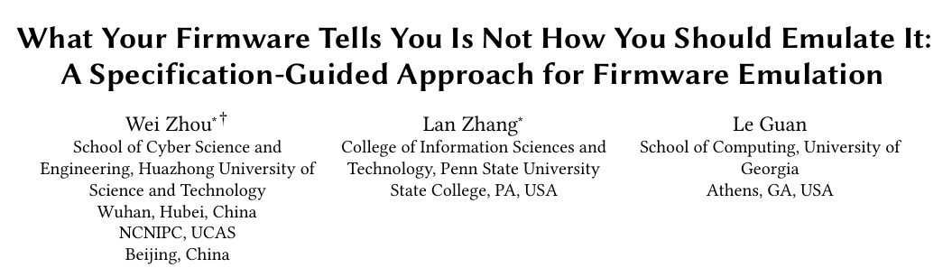
Focus on High Fidelity Execution
“ A high-fidelity emulator can push forward with new security analysis applications other than fuzzing.”

Slide 20
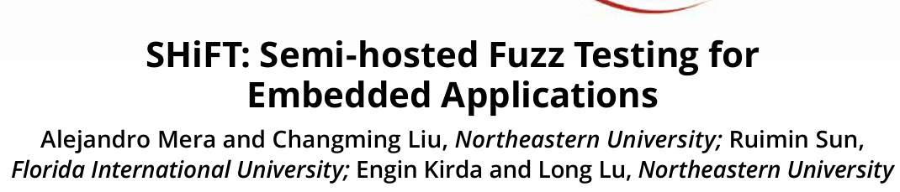
Focus on High Fidelity Execution
“ A high-fidelity emulator can push forward with new security analysis applications other than fuzzing.”
“We envision applications where semihosting catalyzes other verification techniques that benefit from high fidelity.”

Slide 21
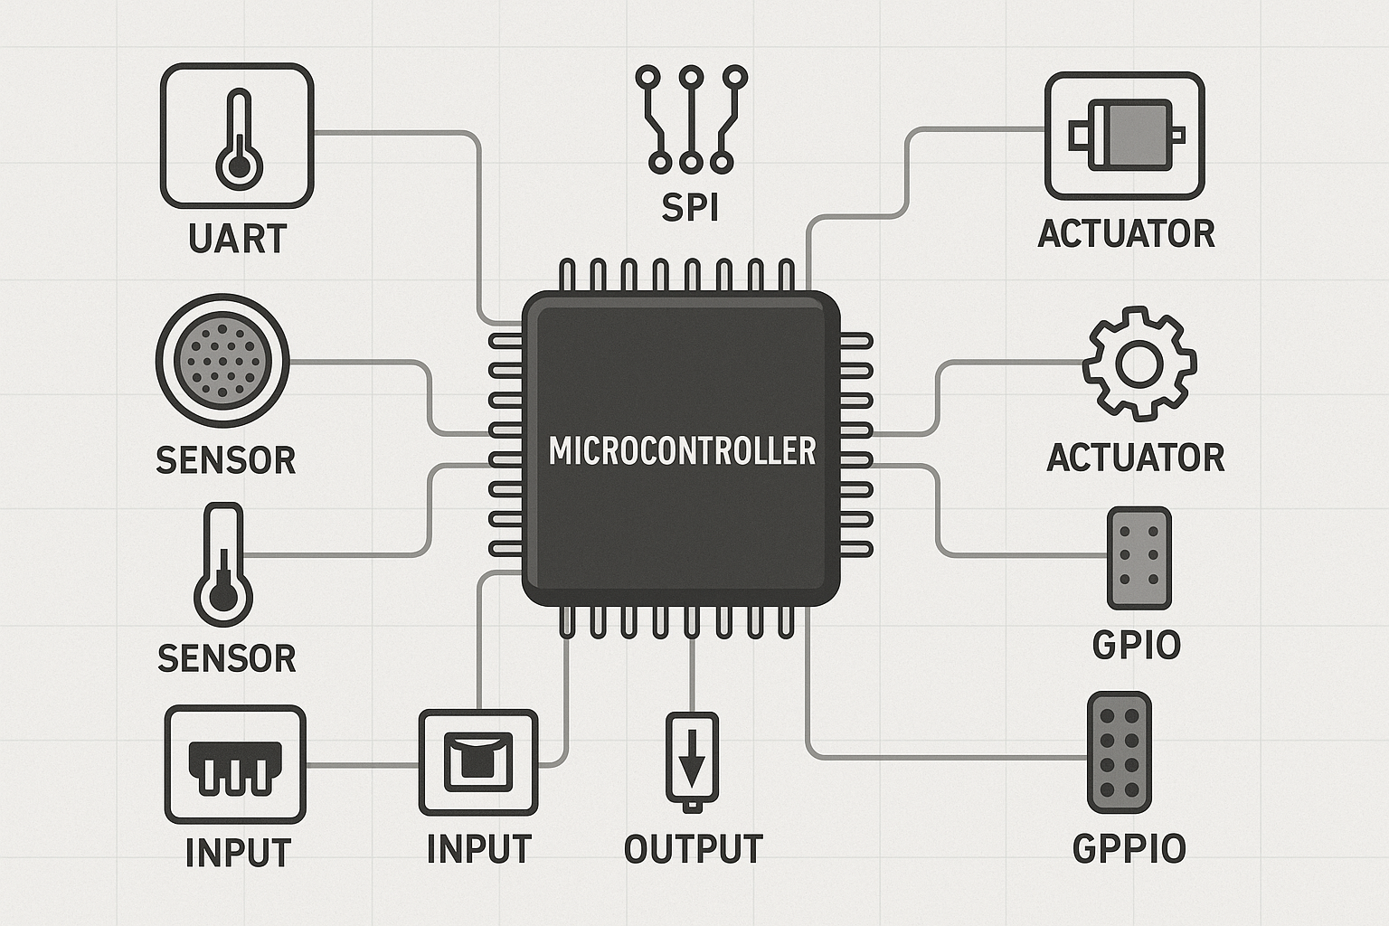
Diversity of Peripherals

Slide 22
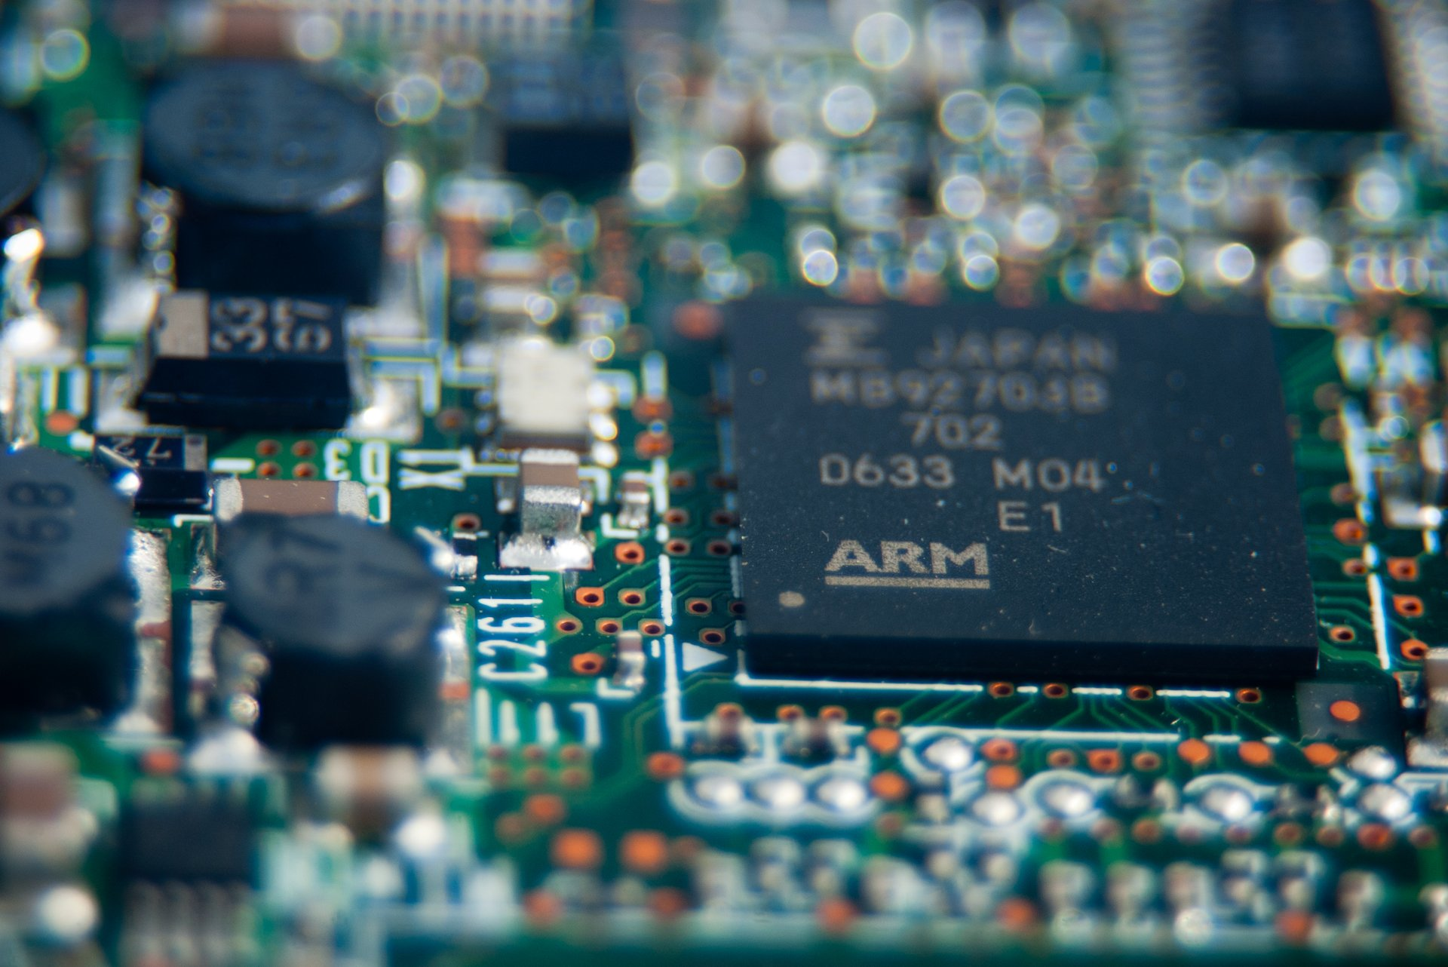
Vendor Specific Customizations

Slide 23
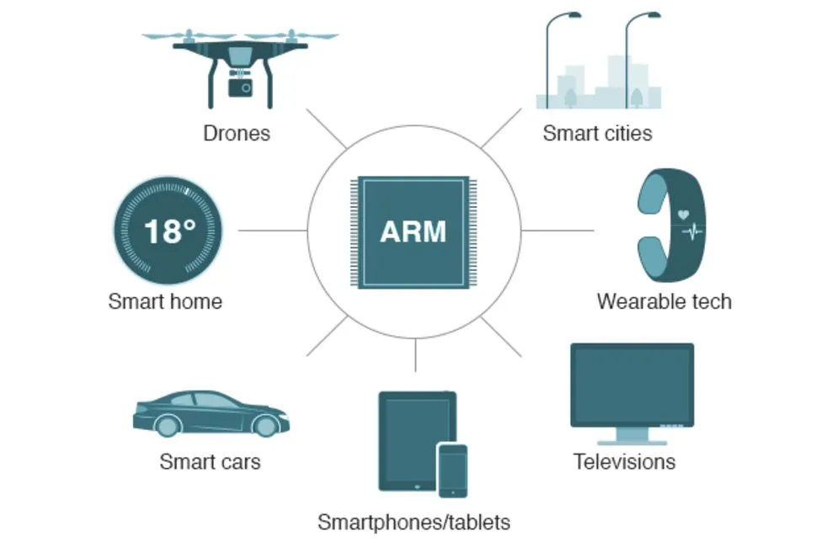
Scalability Issues Due to Diversity

Slide 24


Scalability Issues Due to Diversity

Slide 25


Scalability Issues Due to Diversity

Slide 26
“
A significant challenge to re-hosting firmware is the large expanse of hardware peripherals that need to be emulated.
WRIGHT et.al
Challenges in Firmware Re-Hosting, Emulation, and Analysis

Slide 27
Our Hypothesis
"Teamwork fuels our dreams, and every week is a new opportunity to soar higher together."
“Contrary to popular belief, most embedded bugs can be exposed without high-fidelity execution.”
DENOVAN WRIGHT
LEMIX
Notes:
Before i show some evidence for this claim, let us try to understand what fidelity means.

Slide 28
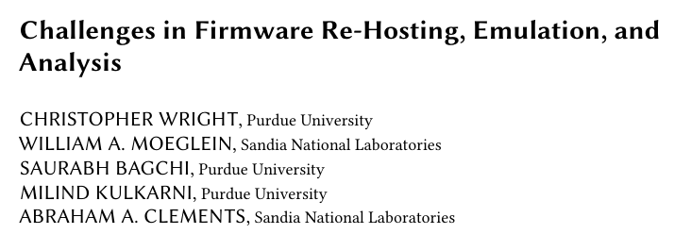
What is Fidelity?
Extrapolating on Previous work, we define Execution Fidelity as a 4-tuple:
EF = ⟨ S, A, P, C ⟩ where each dimension reflects:
S: Language Semantic Fidelity
A: Assembly Execution Fidelity
P: Peripheral Handling Fidelity
C: Clock Fidelity

Slide 29
What is Fidelity?
Extrapolating on Previous work, we define Execution Fidelity as a 4-tuple:
EF = ⟨ S, A, P, C ⟩ where each dimension reflects:
S: Language Semantic Fidelity
A: Assembly Execution Fidelity
P: Peripheral Handling Fidelity
C: Clock Fidelity
Each component is coarsely categorized as: 🔵 Low (L) 🟡 Medium (M) 🟢 High (H)

Slide 30
Empirical Study
“”
Our analysis of the Memory Corruption CVEs from the Rust4Embedded survey indicates that
60 out of 71 (85%) require low-fidelity execution.
LEMIX

Slide 31
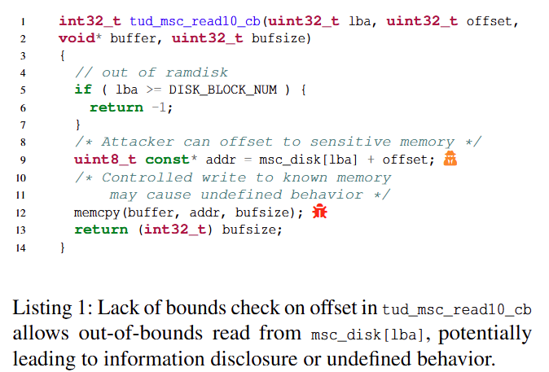
Motivating Example
Notes:
For instance, to observe scheduling bugs, we
need an accurate clock fidelity, i.e., C, in addition to the other omponents, depending on where the bug is. If scheduling
bugs do not involve assembly, we do not need A. We therefore
analyze known vulnerabilities in embedded software to under-
stand the BMF required for memory corruption vulnerabilities
(a common class of vulnerabilities).

Slide 32
Motivating Example
Need to ensure task containing this function gets executed.
Notes:
For instance, to observe scheduling bugs, we
need an accurate clock fidelity, i.e., C, in addition to the other omponents, depending on where the bug is. If scheduling
bugs do not involve assembly, we do not need A. We therefore
analyze known vulnerabilities in embedded software to under-
stand the BMF required for memory corruption vulnerabilities
(a common class of vulnerabilities).

Slide 33
Motivating Example
Also need to provide valid inputs to the arguments to trigger the bug.
Notes:
For instance, to observe scheduling bugs, we
need an accurate clock fidelity, i.e., C, in addition to the other omponents, depending on where the bug is. If scheduling
bugs do not involve assembly, we do not need A. We therefore
analyze known vulnerabilities in embedded software to under-
stand the BMF required for memory corruption vulnerabilities
(a common class of vulnerabilities).

Slide 34
Motivating Example
Some way to recognize the security violation.
Notes:
For instance, to observe scheduling bugs, we
need an accurate clock fidelity, i.e., C, in addition to the other omponents, depending on where the bug is. If scheduling
bugs do not involve assembly, we do not need A. We therefore
analyze known vulnerabilities in embedded software to under-
stand the BMF required for memory corruption vulnerabilities
(a common class of vulnerabilities).

Slide 35
Bug Manifestation Fidelity (BMF)
“Minimum Fidelity required to reach and observe effects of the bugs of interest.”
Notes:
For instance, to observe scheduling bugs, we
need an accurate clock fidelity, i.e., C, in addition to the other omponents, depending on where the bug is. If scheduling
bugs do not involve assembly, we do not need A. We therefore
analyze known vulnerabilities in embedded software to under-
stand the BMF required for memory corruption vulnerabilities
(a common class of vulnerabilities).

Slide 36
Bug Manifestation Fidelity (BMF)
“Minimum Fidelity required to reach and observe effects of the bugs of interest.”
S: Language Semantic Fidelity = High
A: Assembly Execution Fidelity = Low
P: Peripheral Handling Fidelity = Medium
C: Clock Fidelity = Medium
Memory Corruption:
Notes:
For instance, to observe scheduling bugs, we
need an accurate clock fidelity, i.e., C, in addition to the other omponents, depending on where the bug is. If scheduling
bugs do not involve assembly, we do not need A. We therefore
analyze known vulnerabilities in embedded software to under-
stand the BMF required for memory corruption vulnerabilities
(a common class of vulnerabilities).

Slide 37
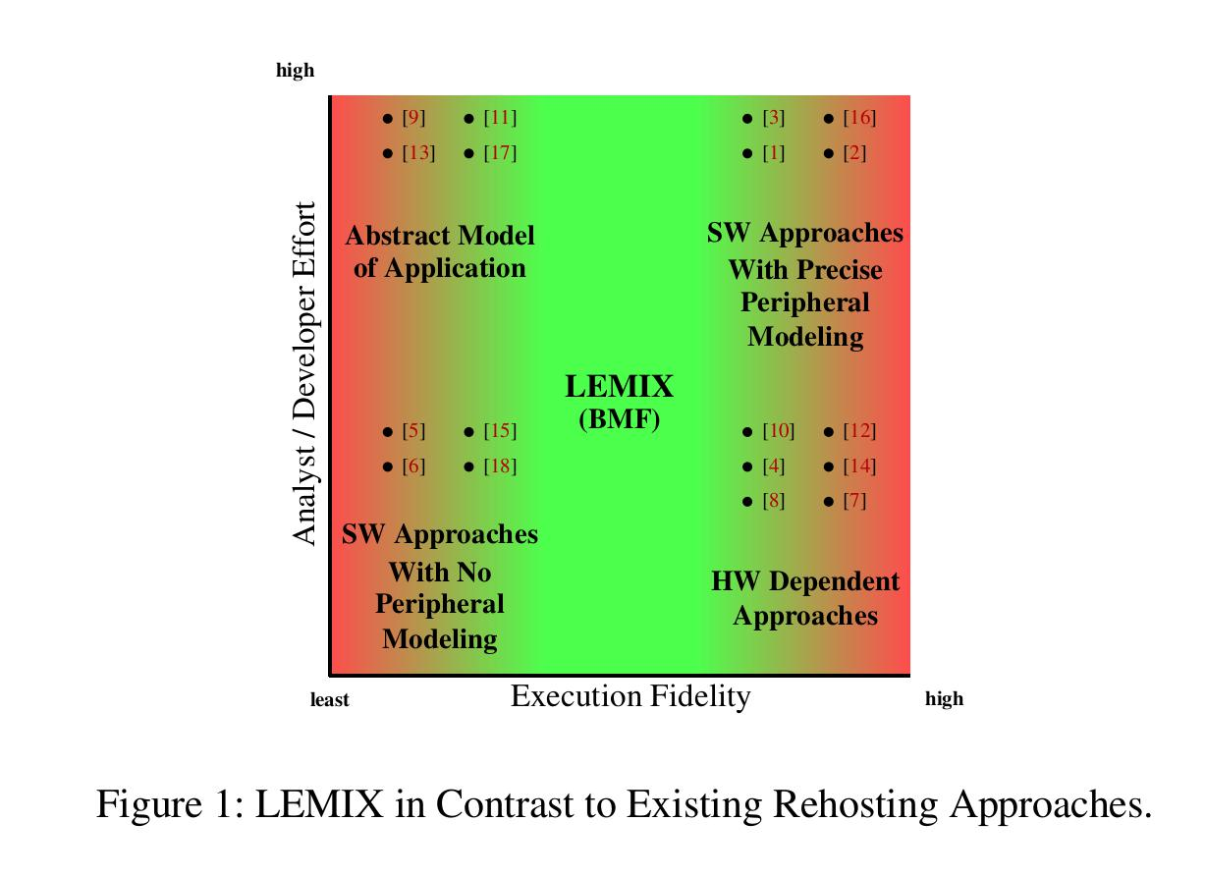
BMF Changes Rehosting Requirements

Slide 38
Proposed Solution
LEMIX

Slide 39
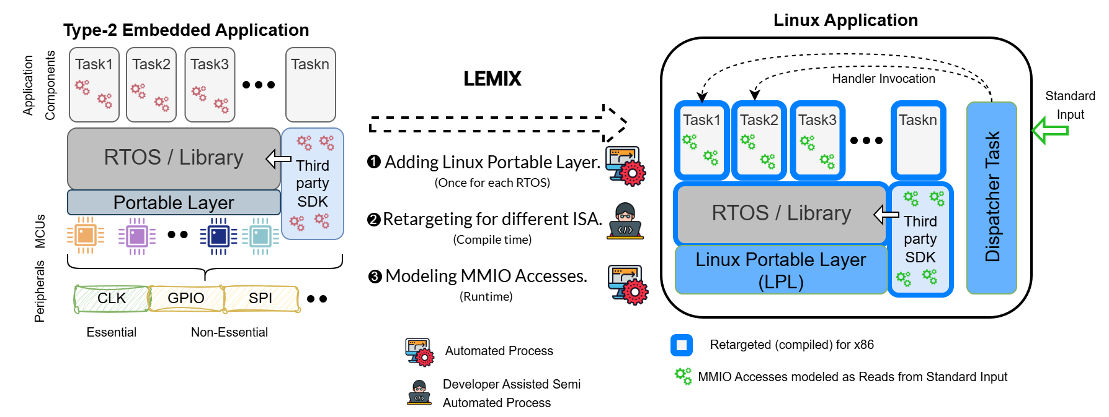
LEMIX : Overview
Multiple tasks run simultaneously with priority-driven execution.

Slide 40
LEMIX : Overview
Handles task scheduling, timers etc.

Slide 41
LEMIX : Overview
Handles task scheduling, timers etc.
Enables RTOS kernel to run on diverse MCUs.

Slide 42
LEMIX : Overview
Use HAL to communicate with the kernel and tasks.

Slide 43
LEMIX : Overview
Replacing Application RTOS files with a POSIX equivalent.

Slide 44
LEMIX : Overview
Compiling the entire application for the x86 architecture.

Slide 45
LEMIX : Overview
Peripherals via runtime instrumentation.

Slide 46
LEMIX : Overview

Slide 47
LEMIX : Overview

Slide 48
LEMIX : Overview

Slide 49
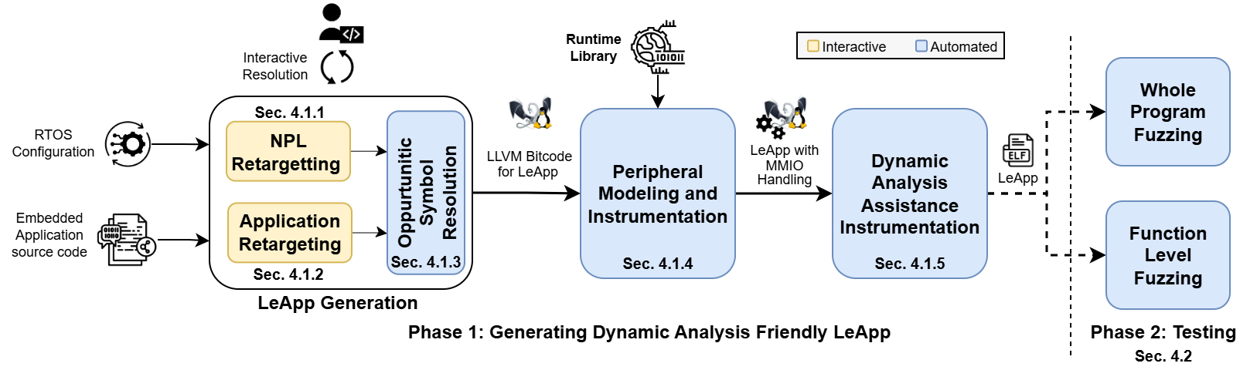
LEMIX : Framework Architecture

Slide 50
LEMIX : Framework Architecture

Slide 51
LEMIX : Framework Architecture

Slide 52
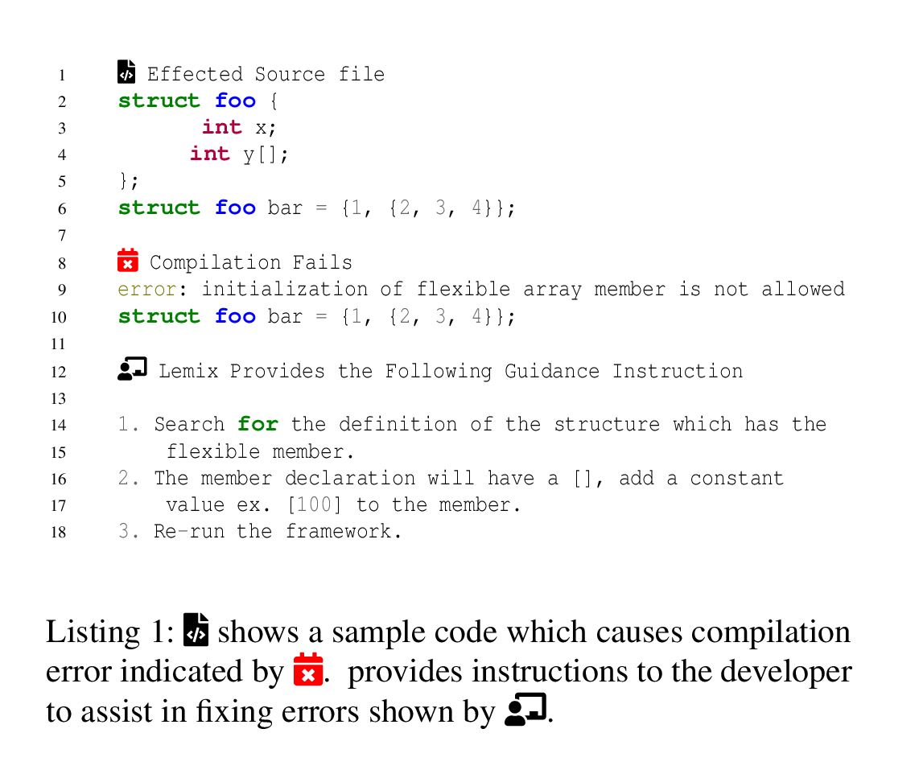
LEMIX : Framework Architecture

Slide 53
LEMIX : Framework Architecture
Automated POSIX-Swap integrates only compilable RTOS configs into the LPL build to ensure maximum compatibility.

Slide 54
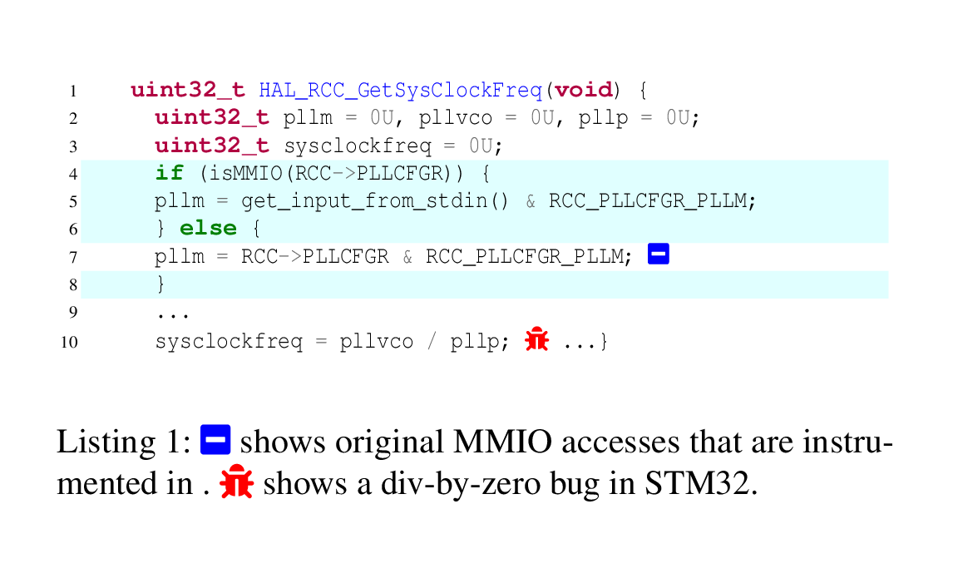
LEMIX : Framework Architecture

Slide 55
LEMIX : Framework Architecture

Slide 56
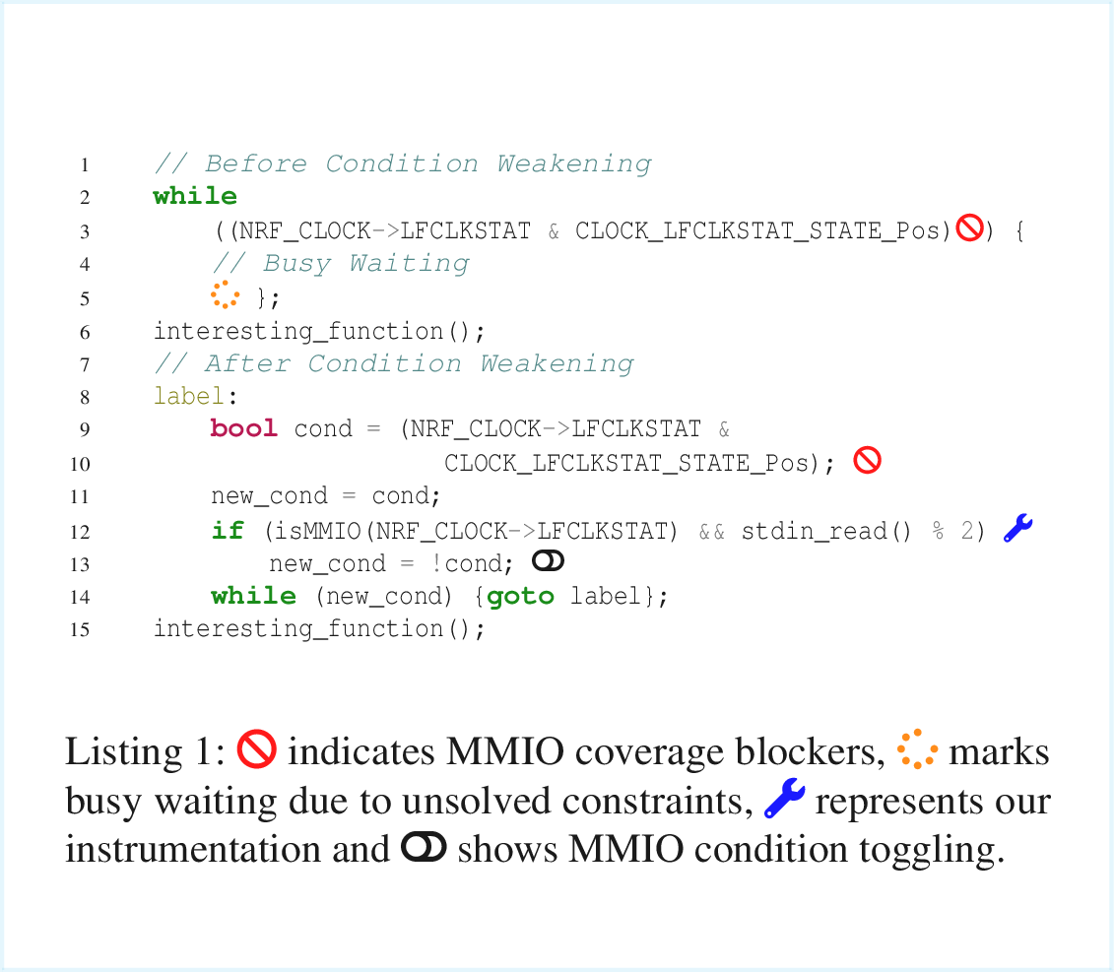
LEMIX : Framework Architecture

Slide 57
LEMIX : Framework Architecture

Slide 58
Evaluation
Notes:
Dataset - 18 apps and 4 RTOSes - representative of real world applications more details in the paper.

Slide 59
Evaluation : Research Questions
How much manual effort does our technique require?
Notes:
dataset

Slide 60
Evaluation : Research Questions
How much manual effort does our technique require?
How effective is our Peripheral MMIO Identification?

Slide 61
Evaluation : Research Questions
How much manual effort does our technique require?
How effective is our Peripheral MMIO Identification?
Effectiveness of 2 different Fuzzing Approaches.

Slide 62
Evaluation : Research Questions
How much manual effort does our technique require?
How effective is our Peripheral MMIO Identification?
Effectiveness of 2 different Fuzzing Approaches.
Comparison with the State Of The Art.

Slide 63
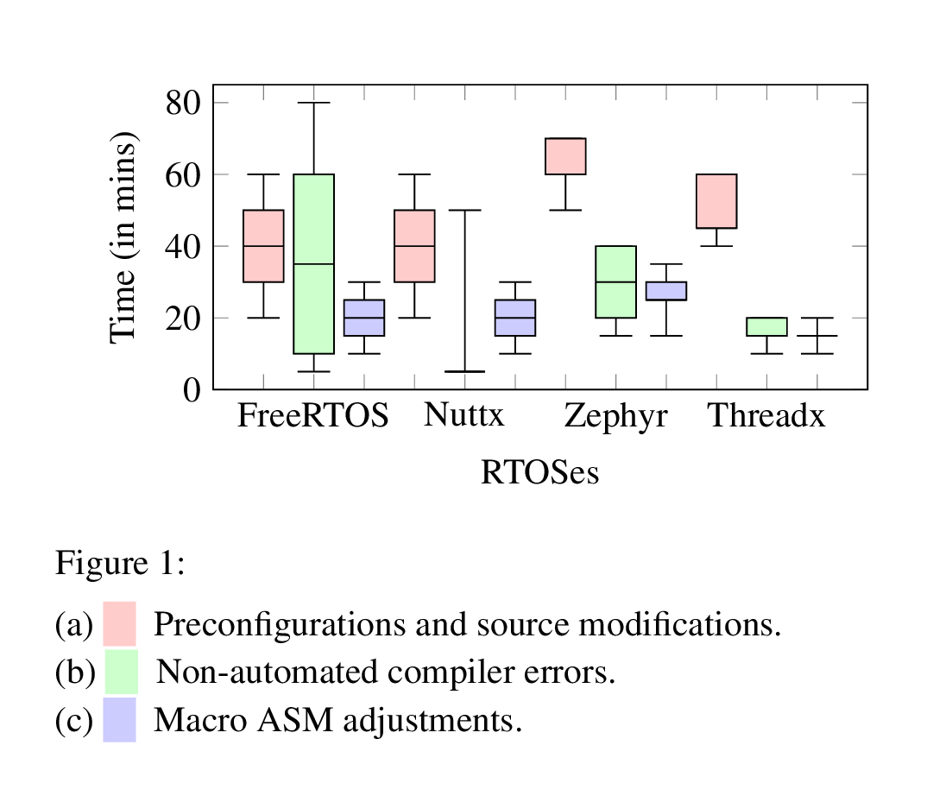

RQ1 : Manual Effort
Low manual effort for compiler fixes (20–40 min median) despite large SLoC changes.

Slide 64
RQ1 : Manual Effort
Inline assembly handling required minimal effort (20–30 min).

Slide 65
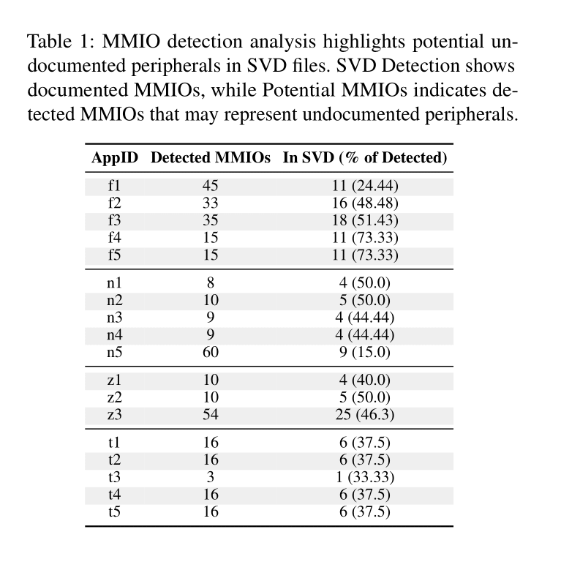
RQ2 : Peripheral MMIO Identification

Slide 66
RQ2 : Peripheral MMIO Identification
None of the discovered ranges conflicted with Ported Application’s Virtual Memory Ranges.

Slide 67

RQ2 : Peripheral MMIO Identification
Over 50% MMIO ranges identified by LEMIX were missing in the SVD files.

Slide 68
RQ2 : Peripheral MMIO Identification
Over 50% MMIO ranges identified by LEMIX were missing in the SVD files.
Manual inspection confirmed they correspond to valid peripheral addresses, highlighting gaps in SVD documentation.

Slide 69
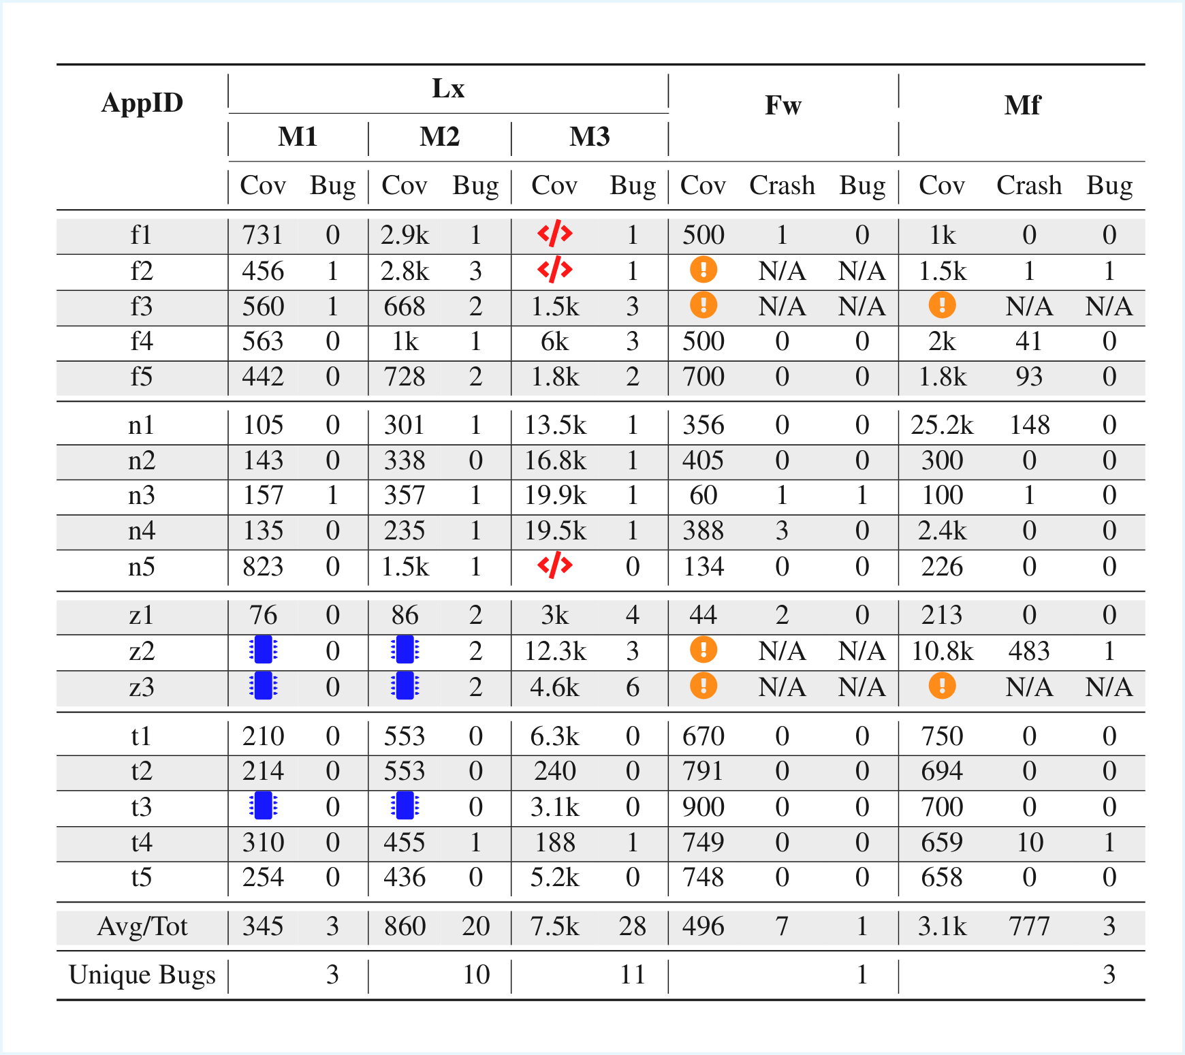
RQ3 & RQ4 : Effectiveness of Fuzzing
Baseline
Condition Weakening
Function Level
Fuzzware
Multifuzz

Slide 70
RQ3 & RQ4 : Effectiveness of Fuzzing
Baseline
Not a significant amount of unique basic blocks covered in the baseline.

Slide 71
RQ3 & RQ4 : Effectiveness of Fuzzing
Baseline
Condition Weakening
Coverage Almost Doubled with M2!!

Slide 72

RQ3 & RQ4 : Effectiveness of Fuzzing
Baseline
Condition Weakening
Function Level
Coverage drastically improved with Function Level Mode!!!

Slide 73

RQ3 & RQ4 : Effectiveness of Fuzzing
Baseline
Condition Weakening
Function Level
Fuzzware
Multifuzz
On average, LEMIX has greater coverage and detection compared to SOTA!!

Slide 74

RQ3 & RQ4 : Effectiveness of Fuzzing
Baseline
Condition Weakening
Function Level
Fuzzware
Multifuzz
M2 and M3 found unique bugs, indicating their individual significance.

Slide 75

RQ3 & RQ4 : Effectiveness of Fuzzing
Baseline
Condition Weakening
Function Level
Fuzzware
Multifuzz
All bugs found by SOTA were also found by LEMIX!

Slide 76

Summary
Scan to Access Paper & Artifacts
LEMIX
Rehost Embedded Applications as Linux Applications without hardware or emulation.
Tackled various challenges related to rehosting.
Proved to be better than State-Of-The-Art.
Found 21 unknown bugs.

